Slide 1

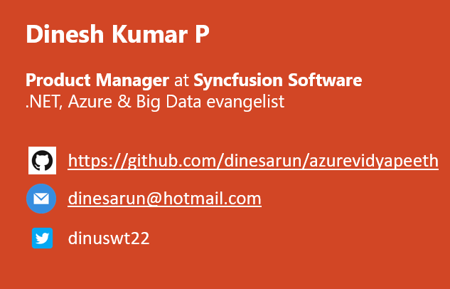
Azure Cosmos DB - End to End - Part 2
Notes:
Good afternoon guys. I am Dinesh Kumar. Product Manager at Syncfusion Software. I manage ‘Data sources’ division of Data Platform team. And I am pretty happy to present this Webinar in Azure Vidyapeeth to this wonderful audience. Here we go!

Slide 2

Agenda
Enter Text
Provide NoSQL data to your users with high availability.
SQL actions like Stored Procedure with data present in Cosmos.
BigData analytics jobs with Azure Cosmos DB and Apache Spark.
Notes:
A lot of background things happen behind the APIs we set.

Slide 3
SQL
Vertically Scalable.
Increase the load on a single server by increasing things like CPU, RAM or SSD.
Adding more floors to the same building.
NoSQL
Horizontally Scalable.
Can handle more traffic by sharding, adding more servers.
Adding more buildings to the neighborhood.
Notes:
Sharding
Splits large data sets into small data sets across multiple MongoDB instances.
Like Hadoop’s distributed cluster architecture.

Slide 4

Azure Cosmos DB
The word “Cosmos” means a well-ordered universe,
Simply mean,
No SQL
Planet Scale
JSON database
Multi – API
Improvised version of Azure ‘DocumentDB’.

Slide 5
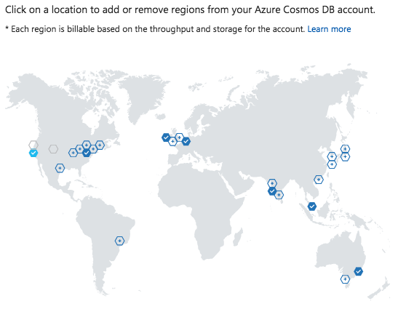
NoSQL data to your users with high availability
What is high availability in lay man term?
Auto sync between all Read / Write regions when we write in a Write region once.
Easy to set Write database(s) and Read database(s).
Automatic Failover for regions.
Notes:
High availability means – Eliminates single point of failure. E.g. Apache Hadoop 1 vs 2
A characteristic of a system which ensure an agreed level of operational performance, for a higher than normal period.
Modernization has resulted in an increased reliance on these systems. For e.g. Hospitals, Data Centers, Military,…

Slide 6
Stored Procedures – Cosmos Data
Write in java script.
Can create, update, read, query, and delete items inside an Azure Cosmos container.
Registered per collection and can operate on any document exist in it.
NoSQL database to have Stored Procedure.

Slide 7
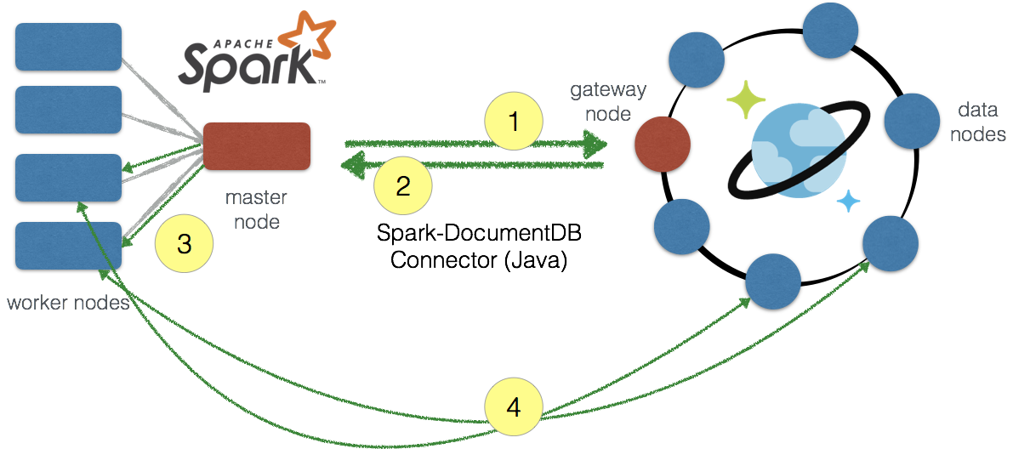
Apache Spark + Azure Cosmos DB
Apache Spark used as a processing layer to process data stored in Cosmos DB.
Multiple ways to connect
Fast connectivity – Spark in cloud like HDInsight, Azure Databricks.
Scenarios
IOT
Spark Streaming
Notes:
Ity 2t552w

Slide 8
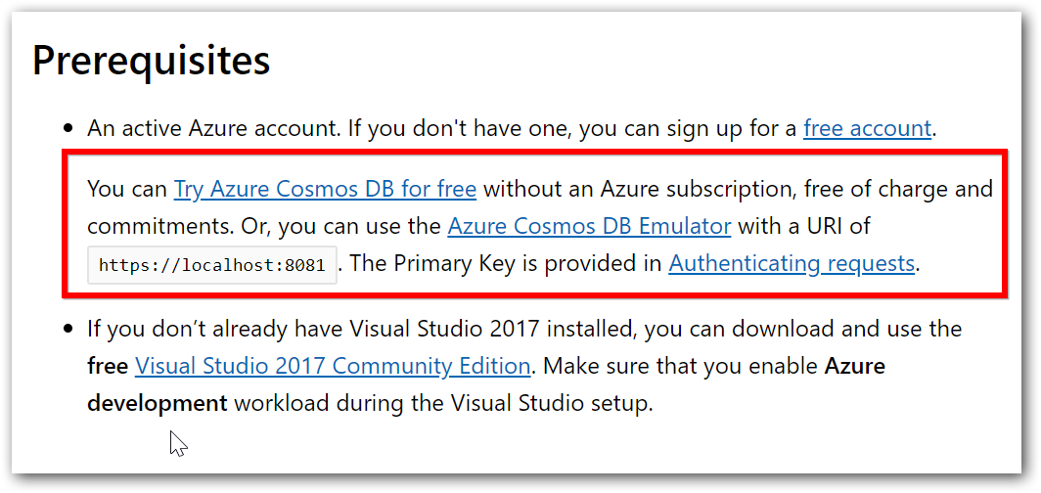
Try Cosmos DB with just an email ID !!
https://docs.microsoft.com/en-us/azure/cosmos-db/sql-api-get-started

Slide 9
Demo
C# SDK for Azure Cosmos DB
‘ToDo list’ application to create, edit, delete and list the todo items - https://github.com/Azure-Samples/documentdb-dotnet-todo-app
Execute a Stored Procedure from C# sample.
Apache Spark with Cosmos DB
Azure Databricks cluster
Read the data from Cosmos db, process using Spark (Azure Databricks cluster) and store the result back to Cosmos DB.

Slide 10
References
Enter Text
C#’s sdk for SQL API - https://docs.microsoft.com/en-us/azure/cosmos-db/sql-api-get-started
Stored Procedure -
https://docs.microsoft.com/en-us/azure/cosmos-db/how-to-use-stored-procedures-triggers-udfs
https://www.c-sharpcorner.com/article/stored-procedures-in-azure-cosmos-db/
Spark (Azure Databricks) + Cosmos DB - https://www.c-sharpcorner.com/article/querying-azure-cosmos-db-in-azure-databricks-using-cosmos-db-spark-connector/

Slide 11
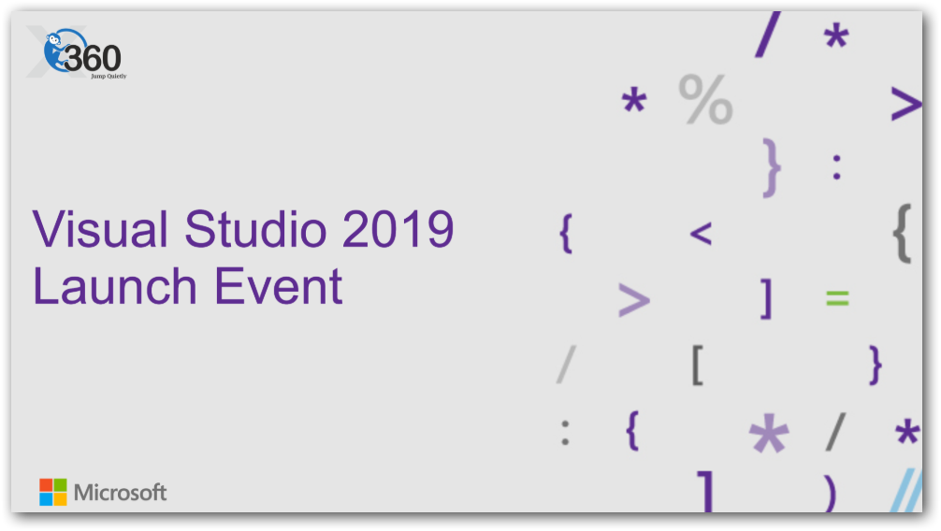
https://www.meetup.com/XMonkeys360/events/258965812/ at Chennai

Slide 12



Enter Text
Questions ?
https://github.com/dinesarun/azurevidyapeeth
dinesarun@hotmail.com
dinuswt22

